Slide 1
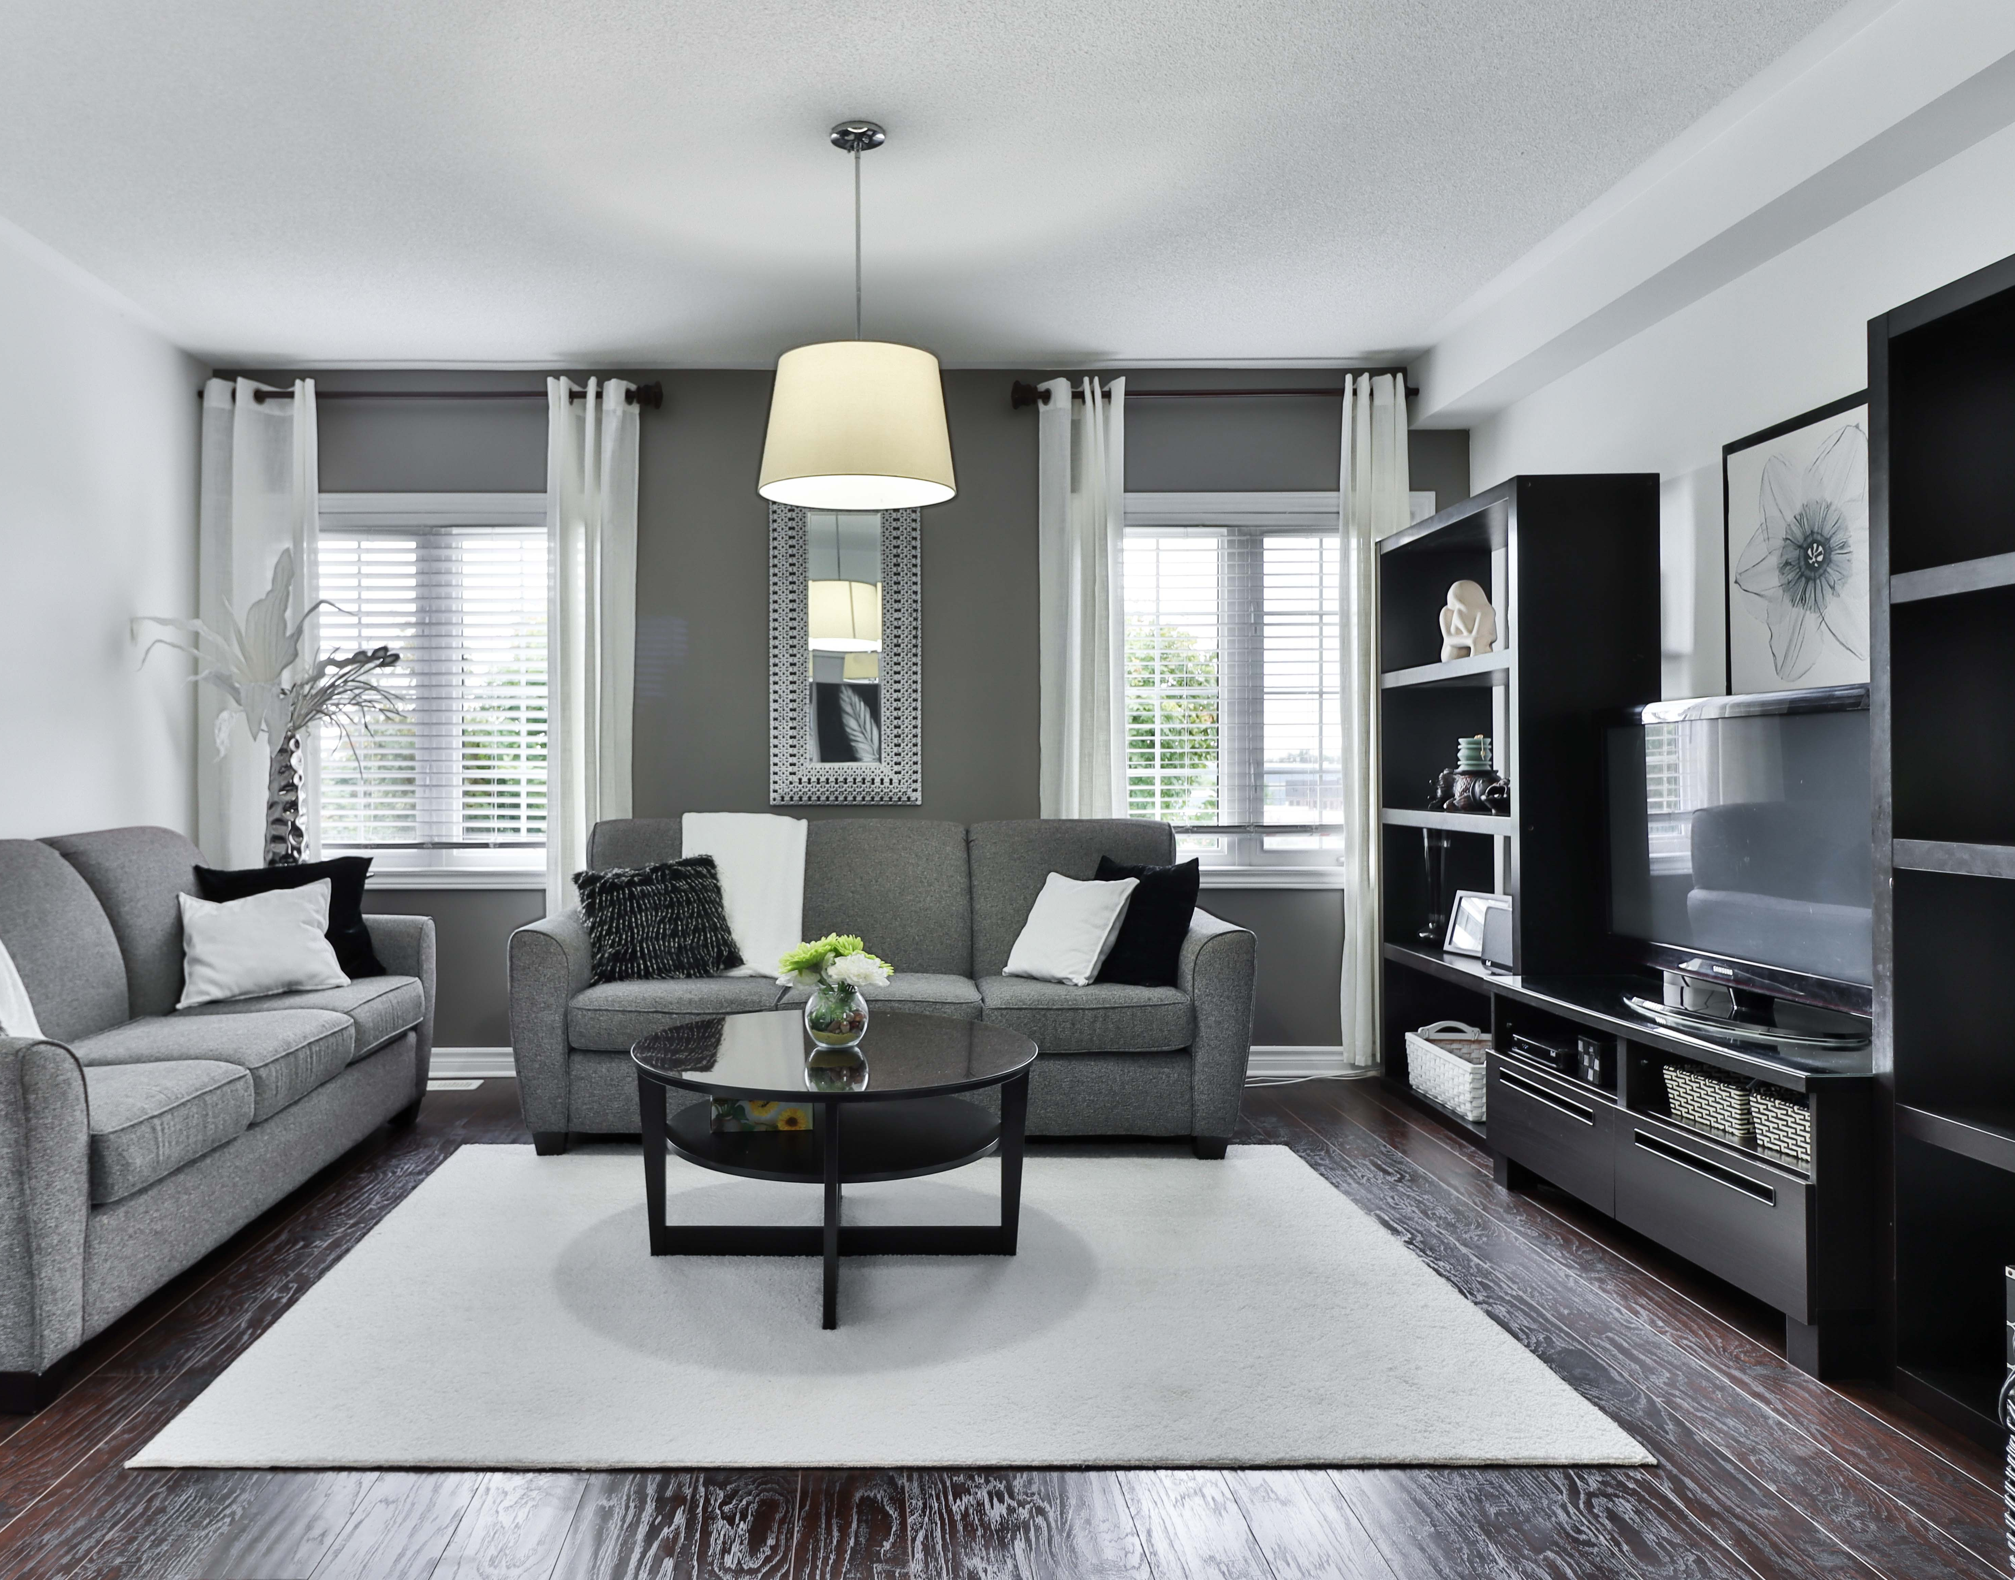
MY FURNITURE APP
“Experience the art of living”
Kiran Kumar - 4JK20IS023 Kiran Shetty - 4JK20IS024

Slide 2
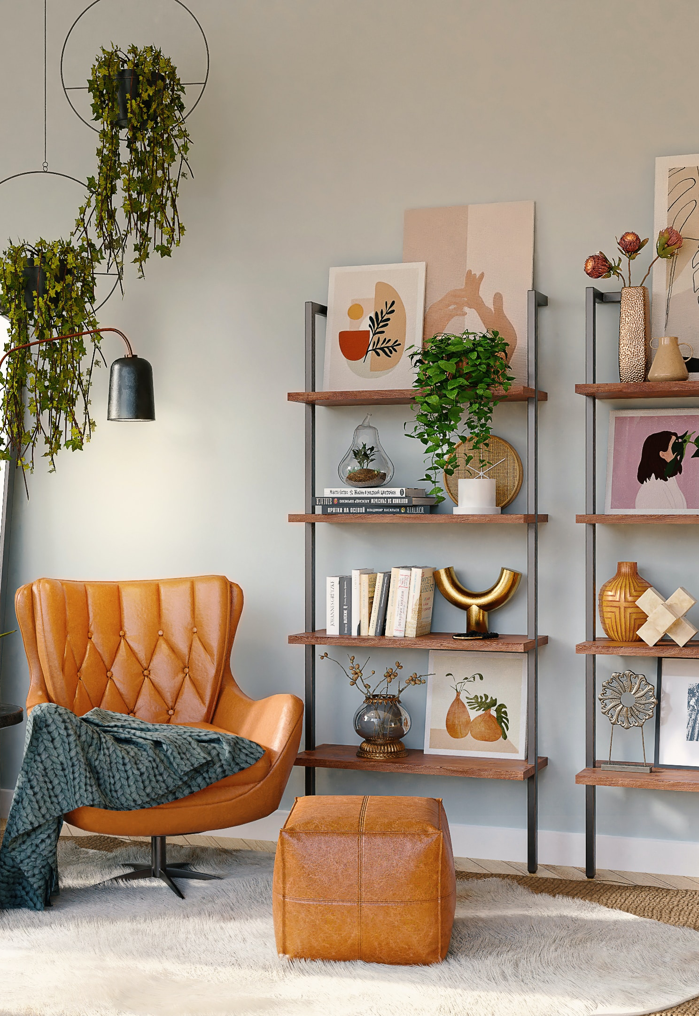
INTRODUCTION
Problem Statement: Finding and purchasing furniture can be inconvenient and time-consuming for customers due to limited variety, high prices, and the need to visit multiple stores.
Solution Overview: Our furniture app offers a user-friendly platform for customers to explore a wide range of furniture, compare prices, and make purchases from the comfort of their homes.
Key Features: Our app provides an extensive furniture catalog, personalized recommendations, augmented reality (AR) functionality for virtual furniture placement, secure payment options, and efficient delivery services.
User Benefits: Our furniture app saves users time and effort, offers a diverse range of furniture styles, enables visualization of furniture in their space, and ensures a seamless shopping experience.
Market Potential: The online furniture industry is growing rapidly, with increasing consumer preference for online shopping. Our app has significant market potential, given the demand and competition in the industry.

Slide 3
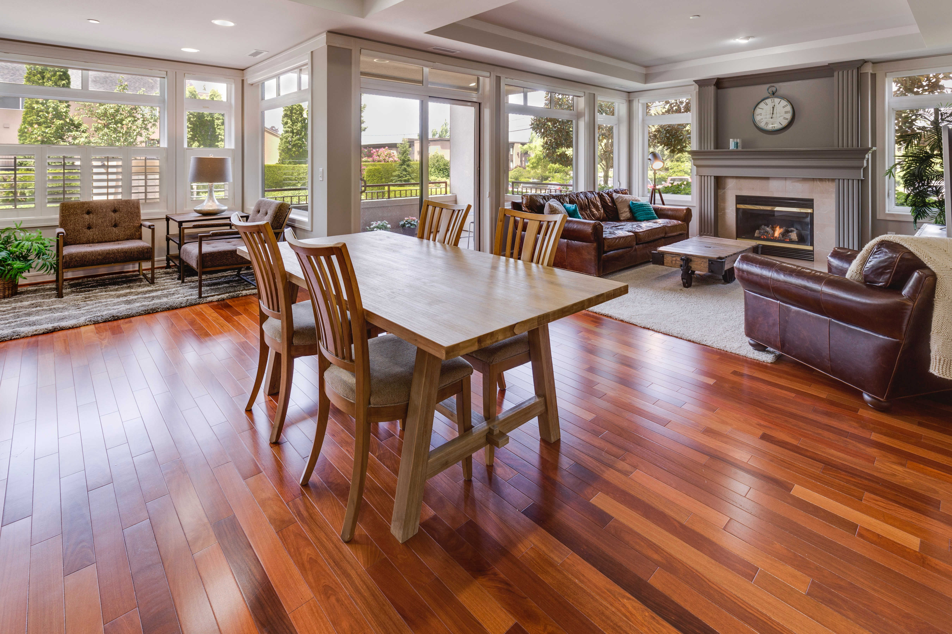
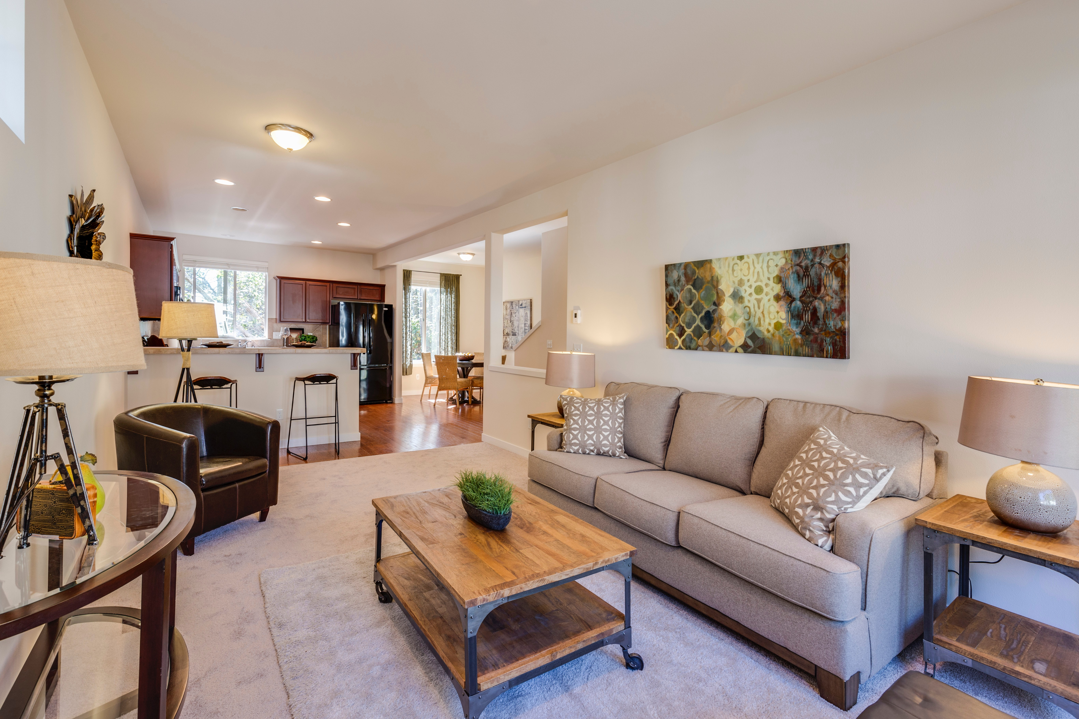
ABSTRACT
Convenience and Selection: Browse, select, and purchase a wide variety of furniture items on our app, offering convenience and extensive options.
User-Friendly Interface: Simplify the shopping process with an intuitive interface, detailed product info, and easy navigation for seamless furniture browsing.
Augmented Reality (AR) Visualization: Visualize furniture in your space through AR technology, enabling informed decisions about size and style.
Streamlined Purchasing Process: Secure payments and multiple delivery options ensure a streamlined purchasing experience on our app.
Personalized Shopping Solution: Find and purchase furniture items that match your preferences, empowering you to create your ideal living space.

Slide 4
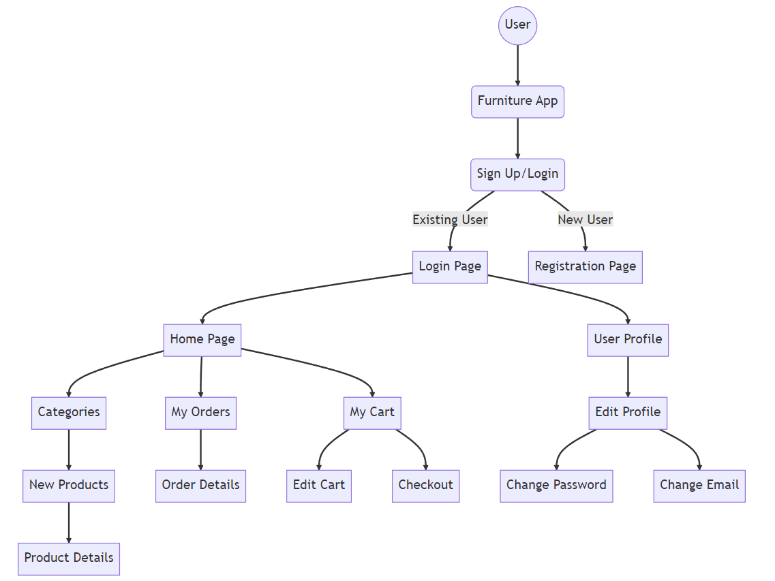
DATA FLOW DIAGRAM
The data flow diagram visually illustrates the flow of information within the furniture app, showcasing the interactions between various components and highlighting the seamless data exchange process stores

Slide 5
REQUIREMENT SPECIFICATION
Software Requirement
Hardware Requirement
Android Studio
XML
Java
Firebase.
Java Development Kit (JDK)
Android SDK
Computer: A desktop or laptop computer capable of running Android Studio Operating System : Windows 7/8/10, macOS, or Linux.
Processor: Intel Core i5 or higher.
RAM: Minimum 8GB (16GB recommended).
Storage: Sufficient free disk space for Android Studio installation and project files.
Display: Minimum 1280x800 resolution.

Slide 6

FUTURE WORK
Integration of augmented reality (AR) technology to allow users to visualize furniture items in their own space before making a purchase.
Implementation of personalized recommendations based on user preferences and browsing history.
Enhancement of the user interface design to further improve usability and accessibility.
Integration with additional payment gateways to provide users with more payment options.
Expansion of the furniture catalogue by partnering with more suppliers and manufacturers.

Slide 7
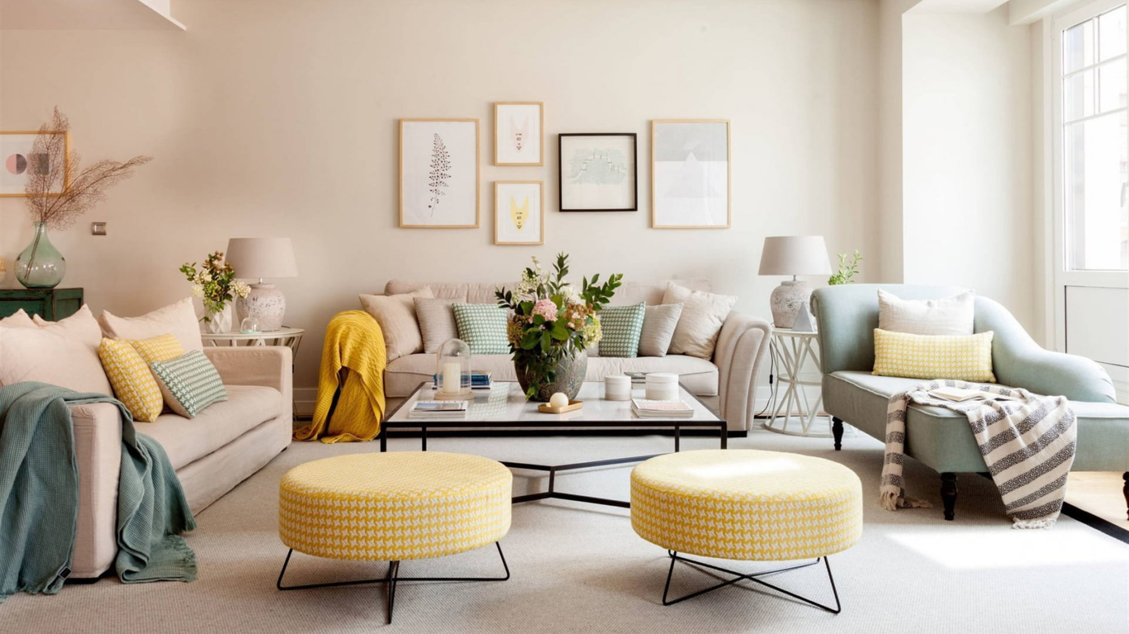
CONCLUSION
Successful Implementation: The My Furniture App has been effectively developed using Java, XML, and Firebase technologies.
Problem Addressed: The app tackles the challenges of furniture management and provides users with a seamless platform for browsing, purchasing, and managing furniture items.
Intuitive User Experience: The app offers an intuitive and user-friendly interface, ensuring a smooth and enjoyable experience for users.
Java Programming: Leveraging the power of Java programming language, the app has been built with robust functionality and efficient handling of media-related tasks.
Visual Appeal: The app incorporates visually appealing design elements to enhance the overall user experience and engagement.

Slide 8
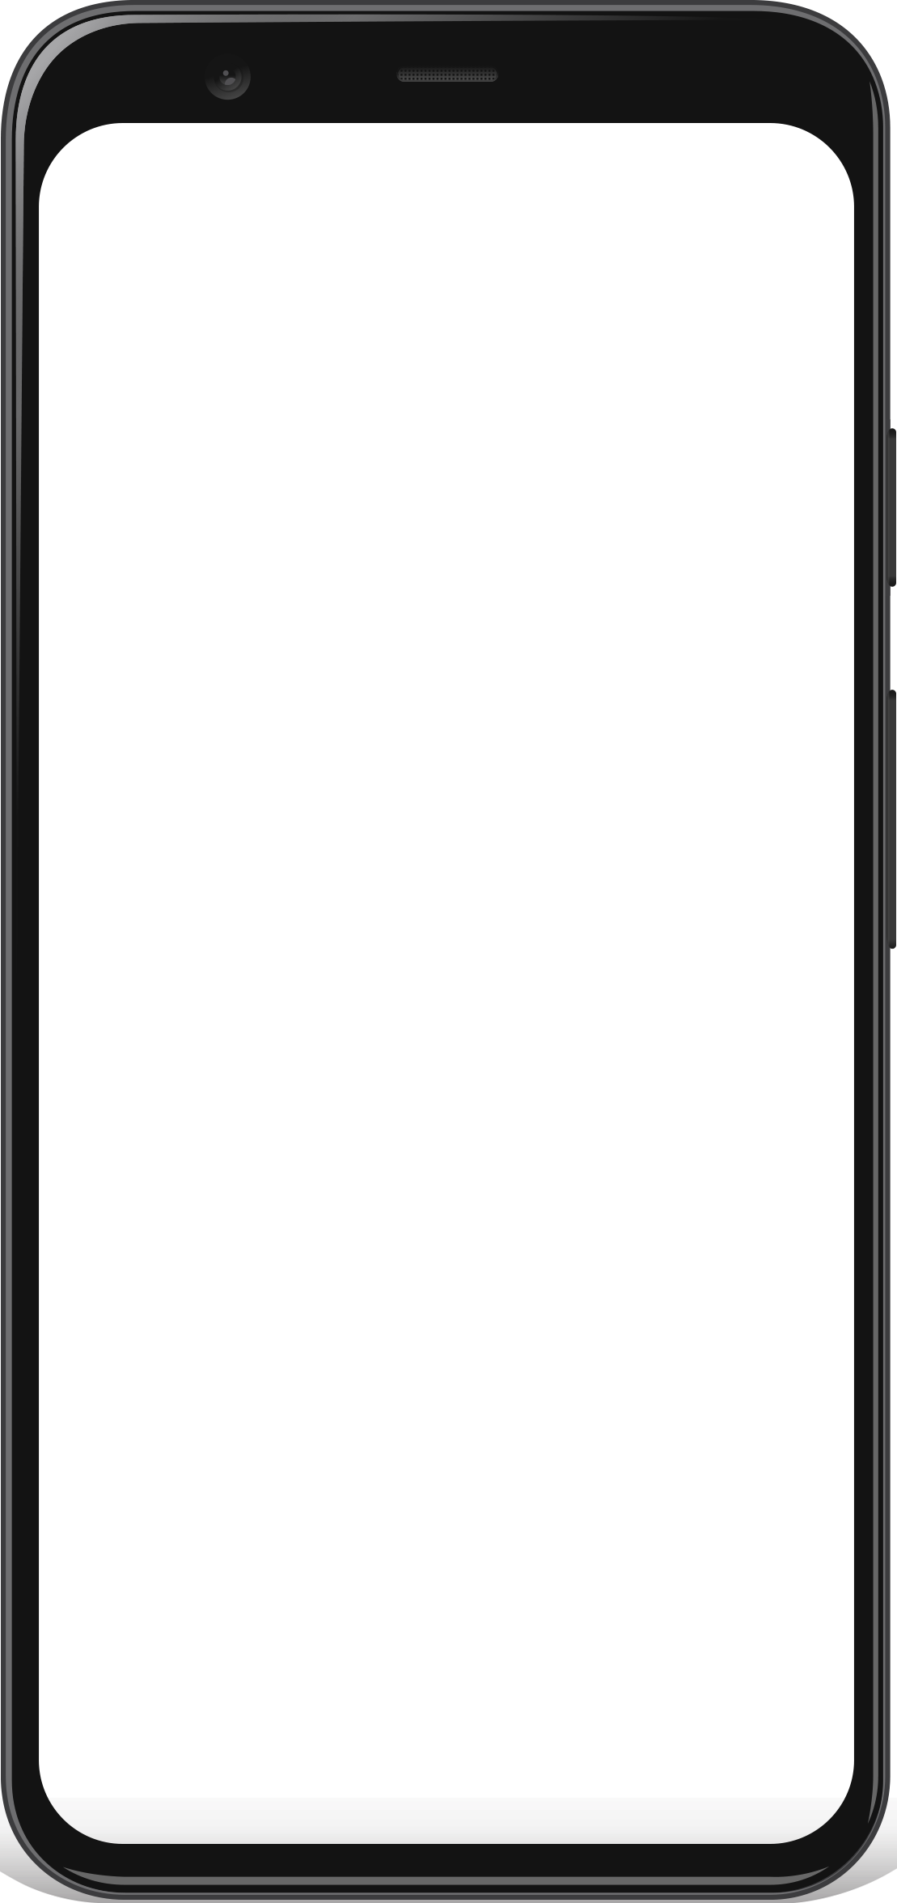


Slide 9
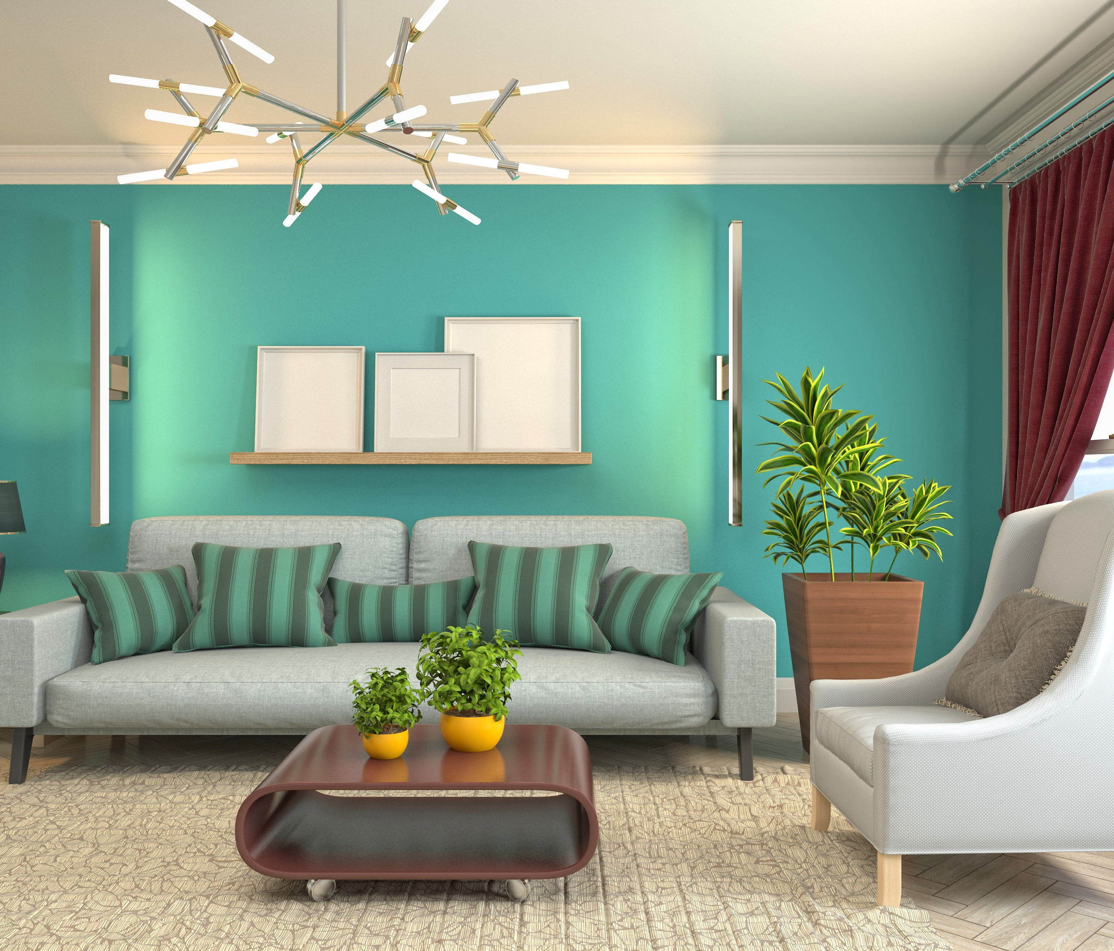
THANK YOU!
Email:
thekirankumarv@gmail.com
kiranshetty1315@gmail.com

